Slide 1
Shiny App 911 calls in Seattle
Cristina Andronescu

Slide 2
Purpose of the app
Provide information about the geographic location and timing of the different types of emergency calls
Allow residents to make informed decisions about areas to avoid based on locations and times where particular types of emergencies occur with higher frequency
Allow emergency responders better insight into the locations and times where greatest demand arises for specific type of responses

Slide 3
Features
Interactive maps
2 drop down menus allowing users to select the level of granularity at which they wish to peruse the data
Neighborhoods
Top locations
2 input sliders allowing users to select the hour and day of
the week for which they wish to view the data

Slide 4
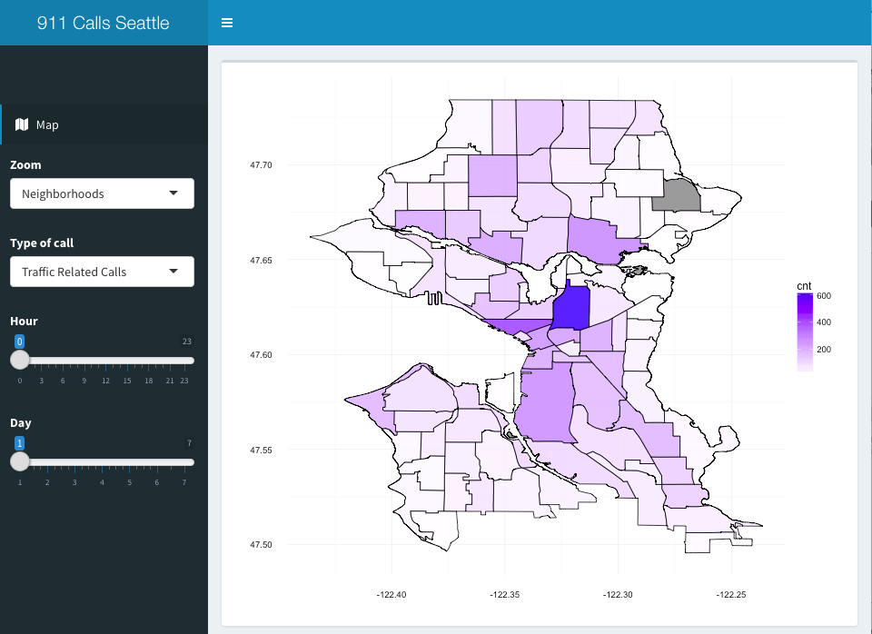
Sample Dashboard

Slide 5
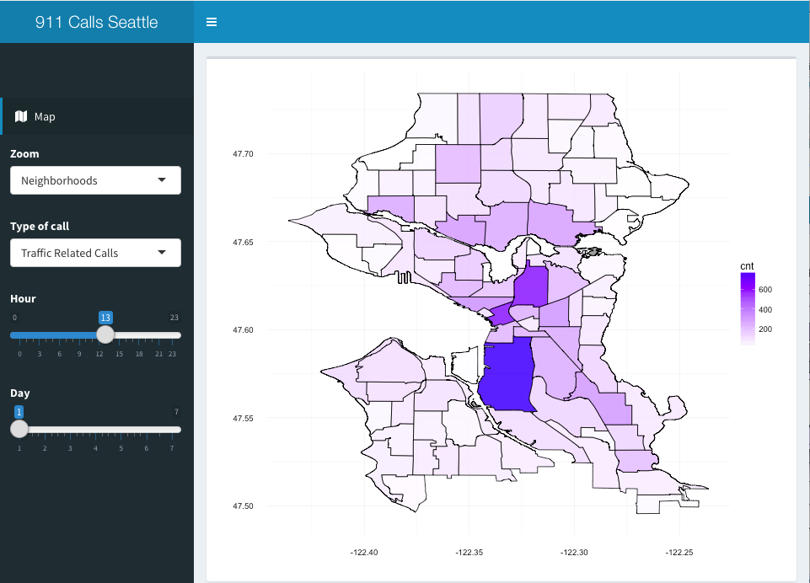
Sample Dashboard

Slide 6
Next Steps
Add analysis by day and neighborhood
Add top locations analysis by day and hour

Slide 7
THANK YOU !

